Slide 1
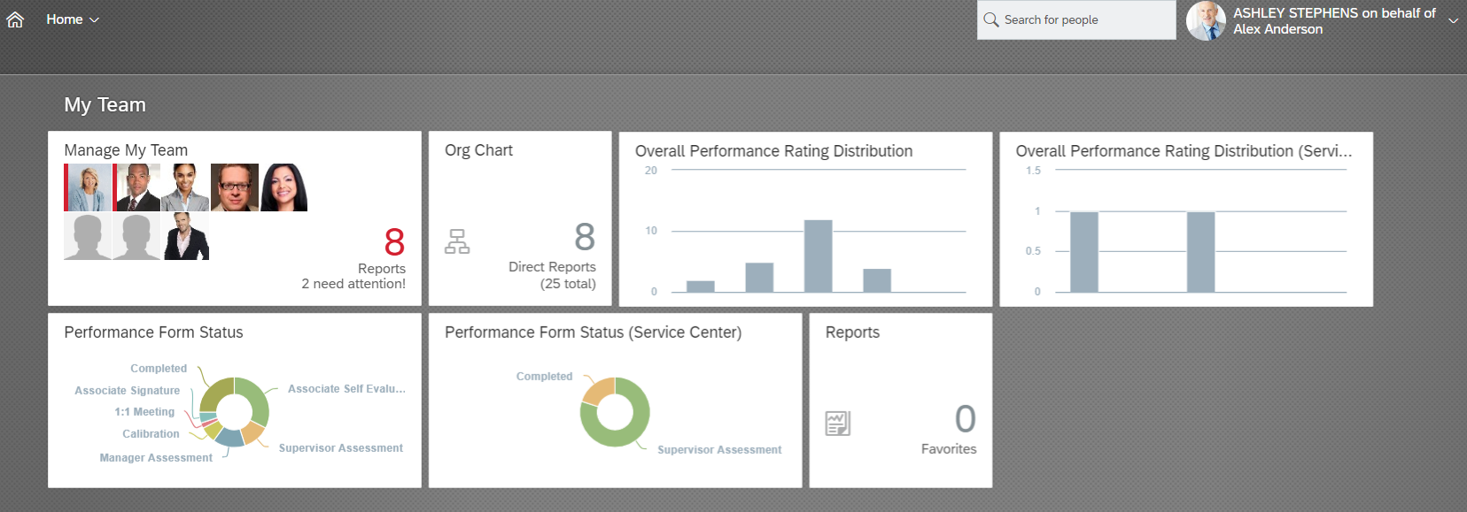
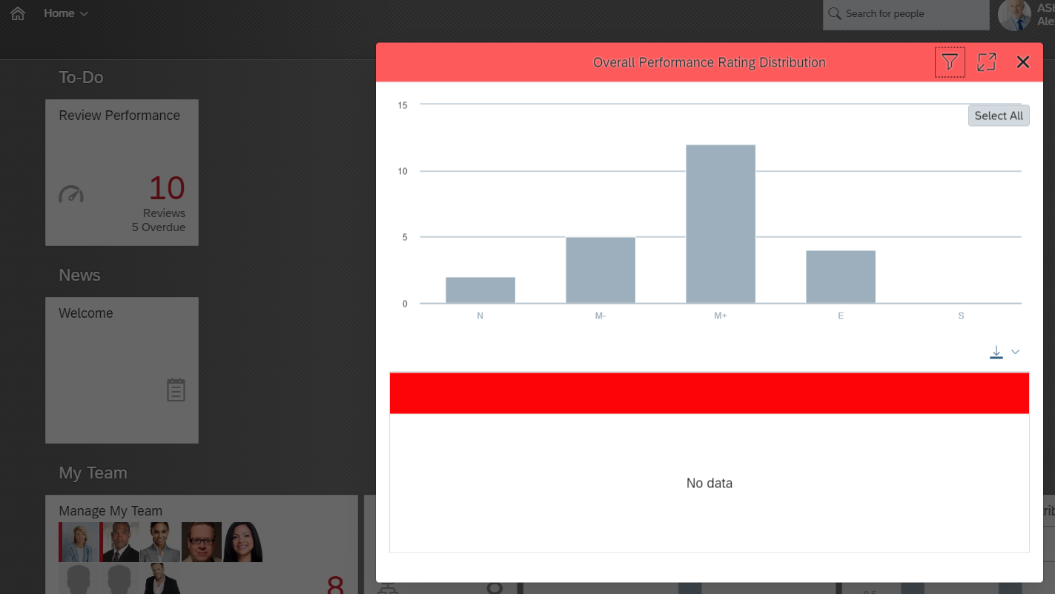
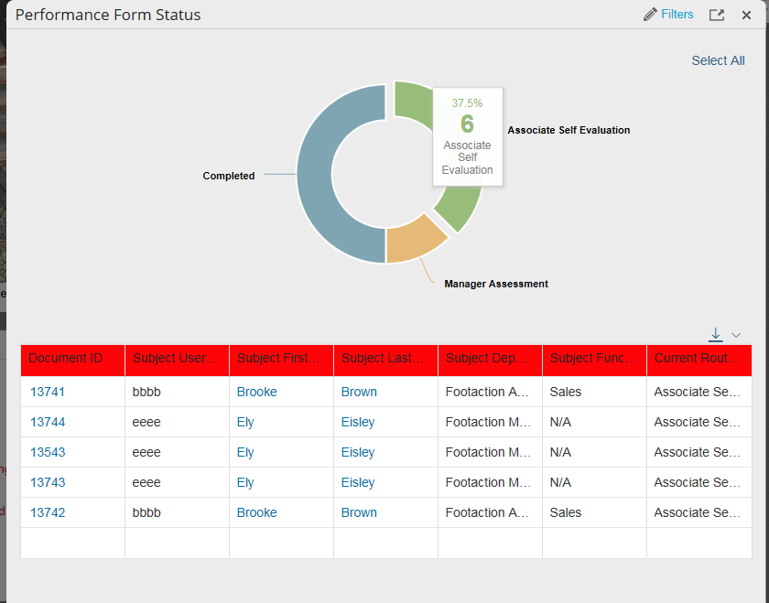
How To: Access Performance Form Status Dashboard
Performance Form Status
Click on the Performance Form Status tile to view the individual report
1
The Title will expand to show additional reporting features
Click on an individual pieces of the graph to see the population with a particular stage in the process
Additional details about associates, that are in the same stage of the process, appears clicking on the graph
Use the filter option to view a particular part of your team
a
c
2
b
* Click the select all to view your entire team
* Click the download arrow to export the report to excel
Note: To pull up the associate’s performance form, click on any of the blue hyperlinks

Slide 2
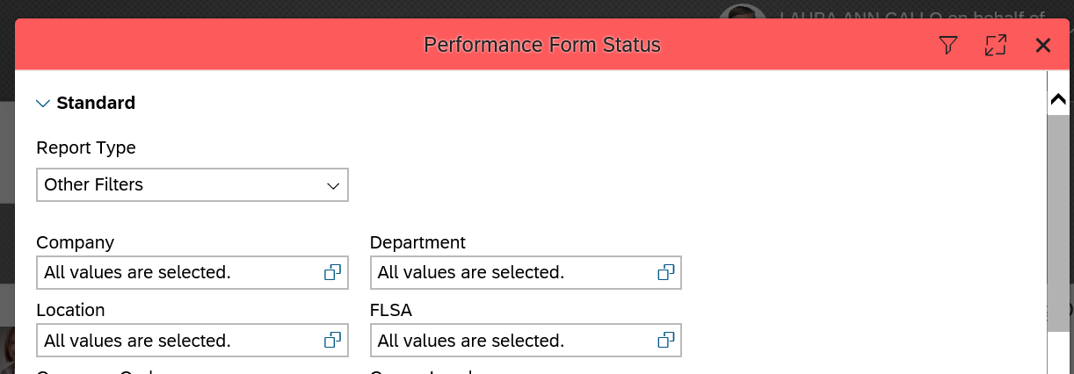
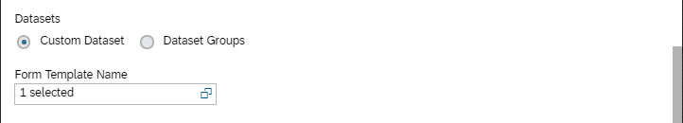
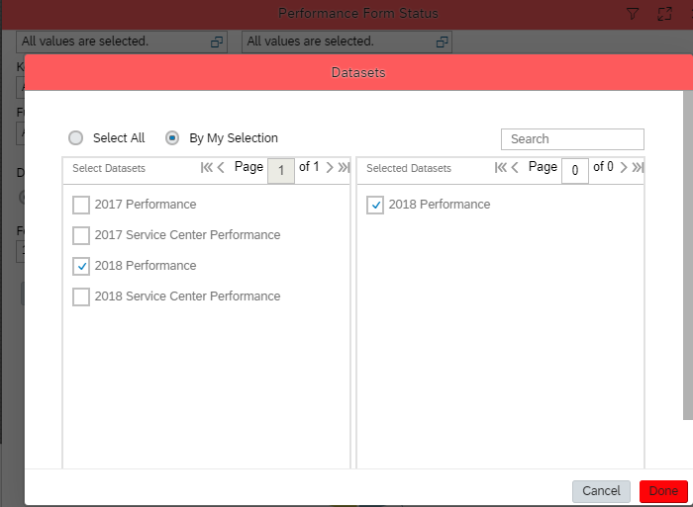
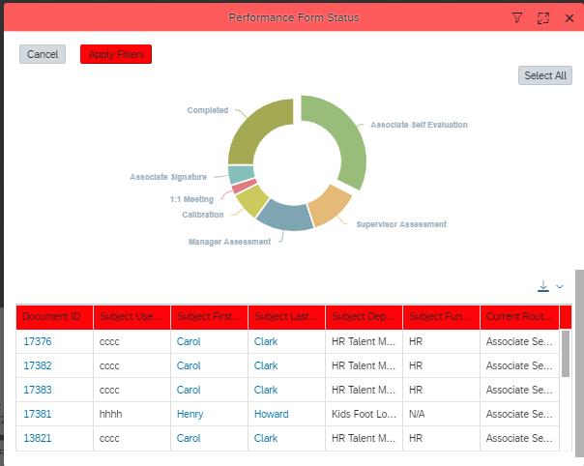
How To: HR Filters on Performance Form Status
Filter options
1
Click on the filter button, use the filters to view a particular part of your team
Starting from- make sure you have the option set to “Other Filters”
Scroll down to the Form Template Name section
select the year of the form you wish to review “2018 Performance” and select done
Back on the options page select “Apply Filters”
You will now be able to see an updated view below
a
2
b
a
c
2
3
Note: All other filters options can be set to “All values are selected”

Slide 3
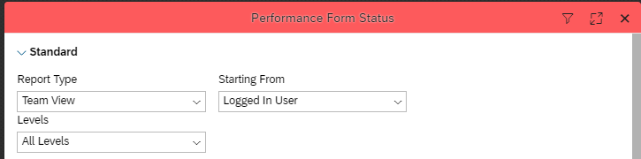
How To: Managers Filter on Performance Form Status
Filter options
1
Click on the filter button, use the filters to view a particular part of your team
Starting from- make sure you have the option set to “Logged in User”
Scroll down to the Form Template Name section
select the year of the form you wish to review “2018 Performance” and select done
Back on the options page select “Apply Filters”
You will now be able to see an updated view below
a
2
b
a
c
2
3
Note: All other filters options can be set to “All values are selected”

